Slide 1
HELLO WORLD
Notes:
SYSDNEY

Slide 2
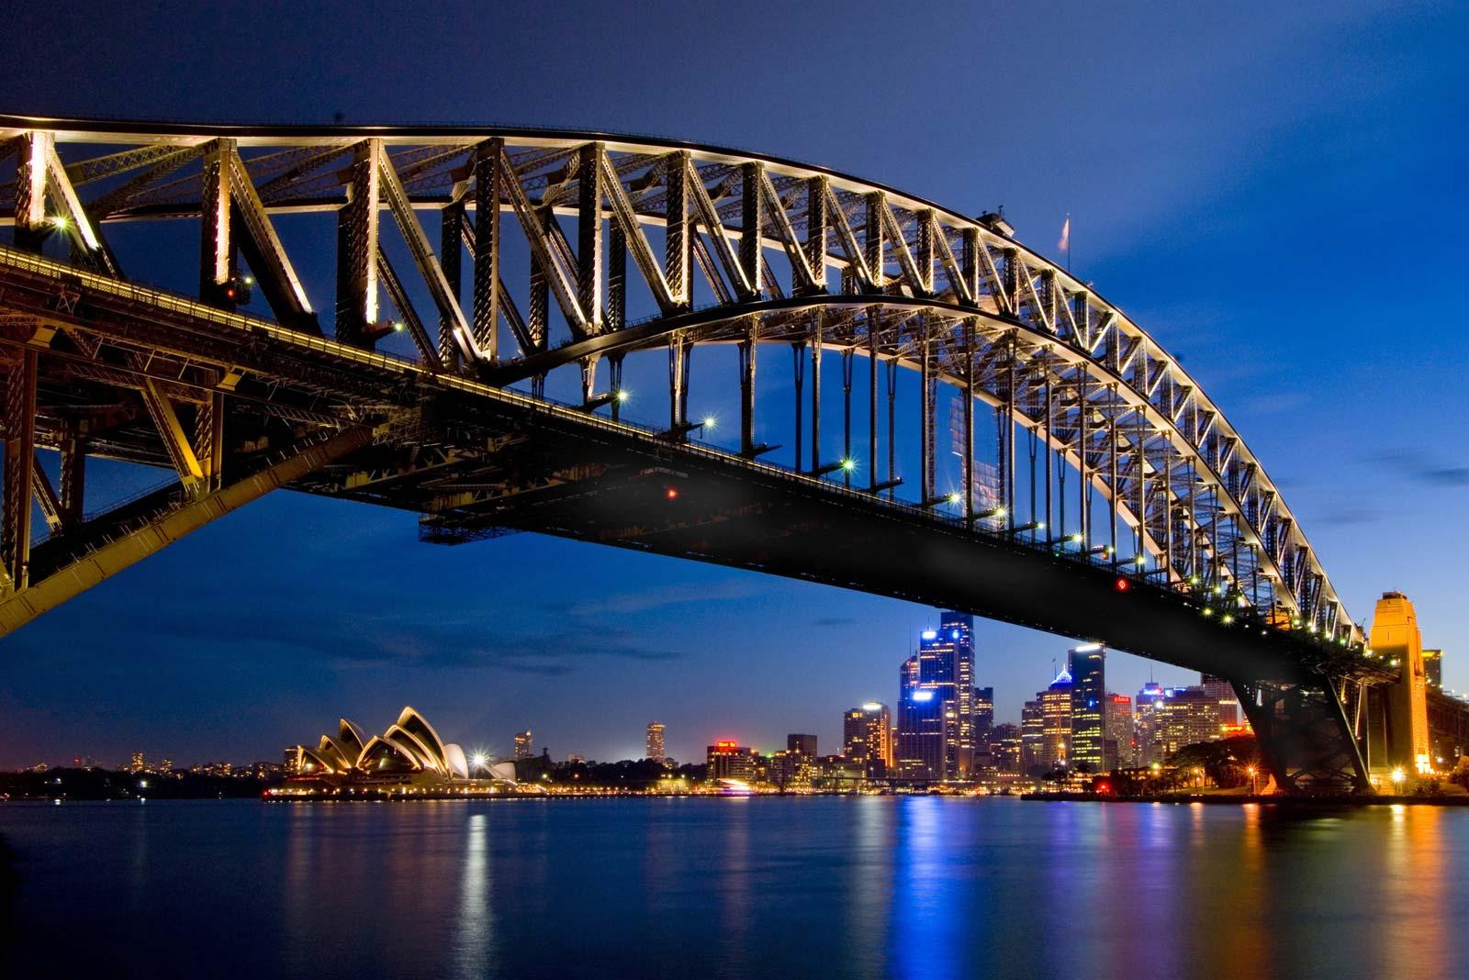
Notes:
SYDNEY

Slide 3
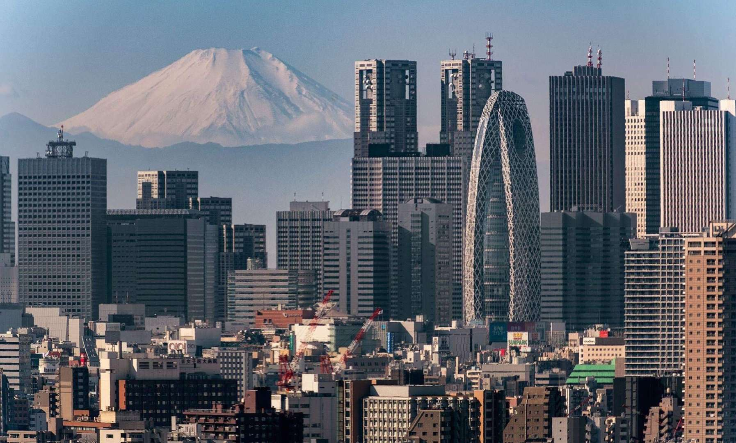
Notes:
TOKYO

Slide 4
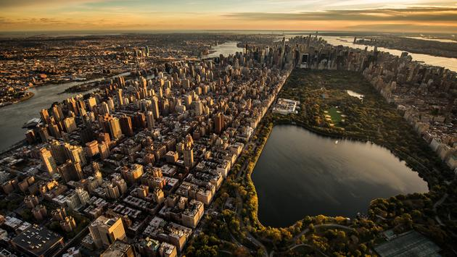
Notes:
NEWYORK

Slide 5
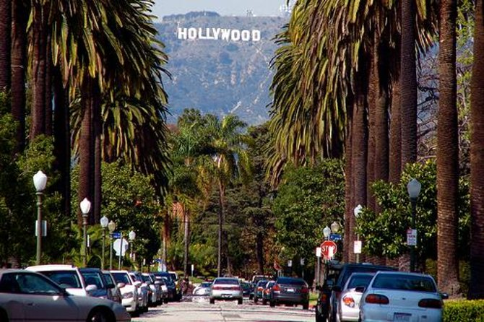
Notes:
Los angeles

Slide 6
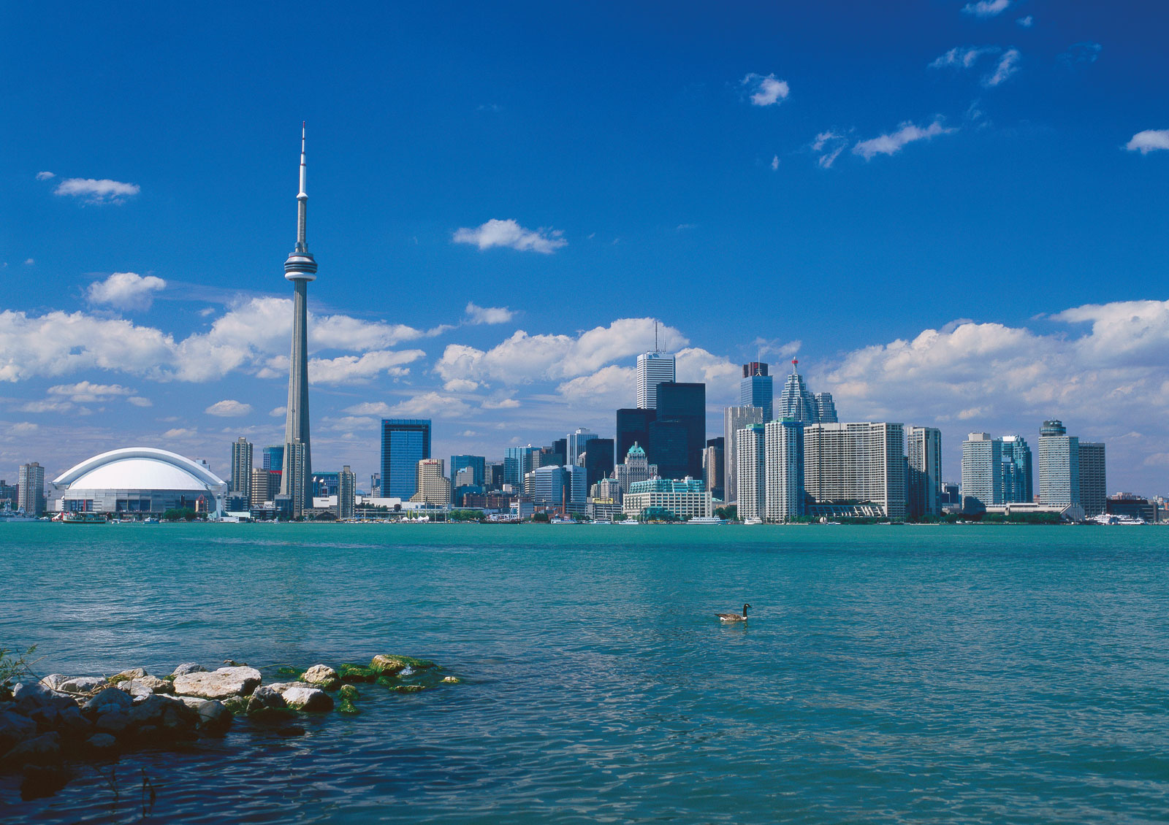
Notes:
toronto

Slide 7
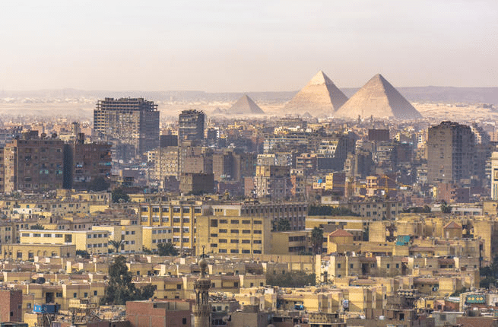
Notes:
cairo

Slide 8
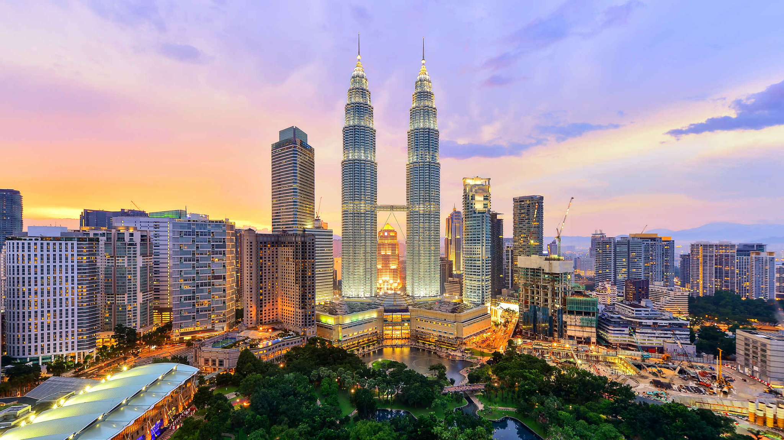
Notes:
kualalumpur

Slide 9
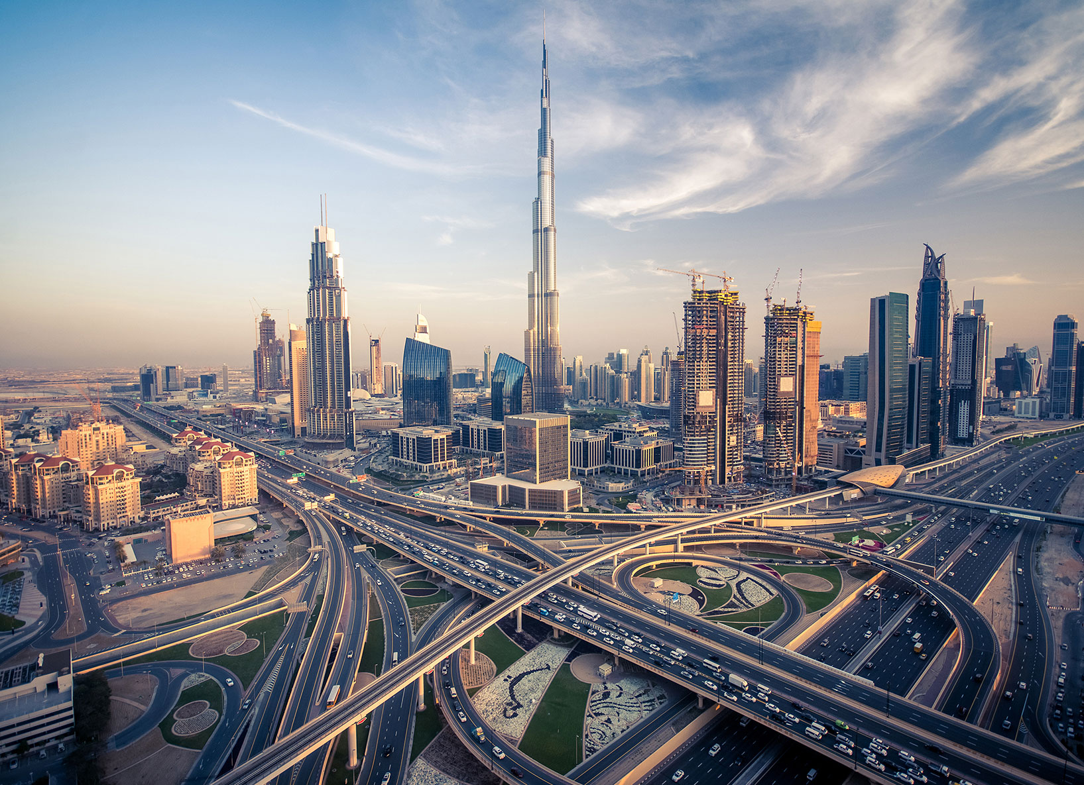
Notes:
dubai

Slide 10
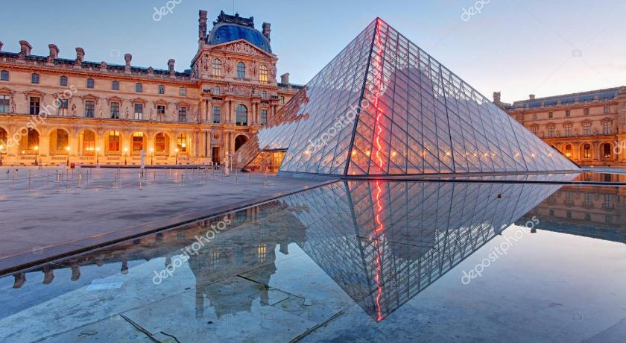
Notes:
paris

Slide 11
Notes:
SYSDNEY

Slide 12
Notes:
SYSDNEY

Slide 13
Notes:
SYSDNEY

Slide 14
Notes:
SYSDNEY

